Slide 1
History and Introduction to Clinical Trials
TCS Internal
1

Slide 2
History of Clinical Trials – Part 1
TCS Internal
2

Slide 3
Global Pharmaceutical Market
Global pharmaceuticals market is worth US$300 billion
2.6 billion $ ~ average cost to research and development a new medicine
10 years ~ average time it takes to bring a new medicine from research pipeline to patents
12% ~ the portion of drug candidates that enter clinical testing and are eventually approved for use by patients
2 out of 3 medicines ever recoup the money invested in R&D
Top 15 Pharma companies by 2014 Revenue
Ref: http://www.who.int/trade/glossary/story073/en/ www.phrma.org
http://www.fiercepharma.com/special-reports/top-15-pharma-companies-2014-revenue

Slide 4
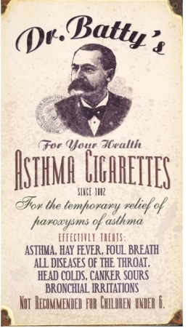
Have asthma? Smoking is the cure!!
Got Asthma?
Smoke cigarettes!!
Your 7 year old nephew got Hay fever:
Give her cigarettes too!!
A 19th century flier
http://blog.psprint.com/designing/5-flyers-youre-glad-you-didnt-post/

Slide 5
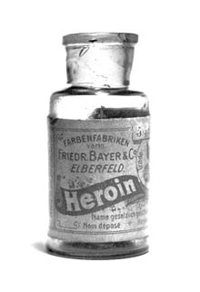
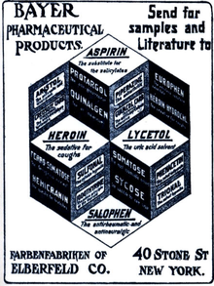
Opium - Heroin
Opium poppy was cultivated in lower Mesopotamia as long ago as 3400 BC
Chemical analysis of opium in the 19th century:
Two alkaloids, codeine and morphine.
The head of Bayer's research department reputedly coined the drug's new name, "heroin," based on the German heroisch, which means "heroic, strong.'Bayer scientists were not the first to make heroin, but their scientists discovered ways to make it, and Bayer led commercialization of heroin.
From 1898 through to 1910, diacetylmorphine was marketed under the trademark name Heroin as a non-addictive morphine substitute and cough suppressant
Ref: http://en.wikipedia.org/wiki/Heroin

Slide 6

2015: Australian Father Treating 2 year Old Daughter Faces 20 Years Jail
Treating cancer, ethics, legal drug
2 year old baby girl with stage 4 Neuroblastoma
a pediatric cancer that develops from immature nerve cells
a very serious abdomen cancer
In Australia, medical marijuana is illegal
Medical use of cannabis is legal in many countries
https://www.yahoo.com/parenting/dad-arrested-for-giving-cannabis-oil-to-daughter-108654025667.html

Slide 7
History of Clinical Trials – Part 1
Outline
Nuremberg Code
Declaration of Helsinki
Thalidomide Disaster

Slide 8
Nuremberg Code
The Second World War (WW II, 1939-1945)
The Allies and the Axis
The Holocaust (1941-1945)
Jews were targeted
Methodically murdered in a genocide
By the Nazi regime
Nazi human experimentation
The Nuremberg Trial
A series of military tribunals
Held by the Allied forces after World War II
In the city of Nuremberg, Germany
Trying 23 of the most important political and military leaders of the Nazi Germany
The Doctors Trial
The Nuremberg Code
Ref: Wikipedia

Slide 9
Nuremberg Code – Contd.
The Doctors’ Trial (United States of America v. Karl Brandt, et al.)
Karl Brandt: a German physician
Hitler's escort physician: 1934
A member of Hitler's inner circle
Brandt’s medical ethics:
Society’s weakest, most invalid and incurable members were only parts that should be removed
Discussed multiple killing techniques during the initial planning of the euthanasia program with Hitler
Trial focused on doctors involved in the human experiments in concentration camps
Doctors’ argument in the trial:
No international law regarding medical experimentation
The Nuremberg Code
Ref: Wikipedia

Slide 10
Nuremberg Code – A set of research ethics principles for human experimentation
Voluntary Consent
For the good of the society
Based on the results of animal experimentation and a knowledge of the natural history of the disease
Should be so conducted as to avoid all unnecessary physical and mental suffering and injury
No experiment should be conducted where there is a prior reason to believe that death or disabling injury will occur
Ref: Wikipedia
The degree of risk to be taken should never exceed that determined by the humanitarian importance of the problem to be solved by the experiment.
Proper preparations and adequate facilities to protect the experimental subject against even remote possibilities of injury, disability, or death.
Should be conducted only by scientifically qualified persons.
Subject should be at liberty to bring the experiment to an end.
The scientist in charge must be prepared to terminate the experiment at any stage.

Slide 11
Declaration of Helsinki - 1964
An idea born in the House of the British Medical Association in 1945
An informal conference of doctors
From several countries
Convened in London
To initiate plans for an international medical organization
The World Medical Association formed in 1946
1946: Declaration of Geneva
A modernized wording of the ancient oath of Hippocrates
Recommendations guiding physicians in biomedical research involving human subjects
Declaration of Helsinki – 1964
A set of ethical principles regarding human experimentation
Several revisions later on
Ref: Wikipedia, www.wma.net

Slide 12

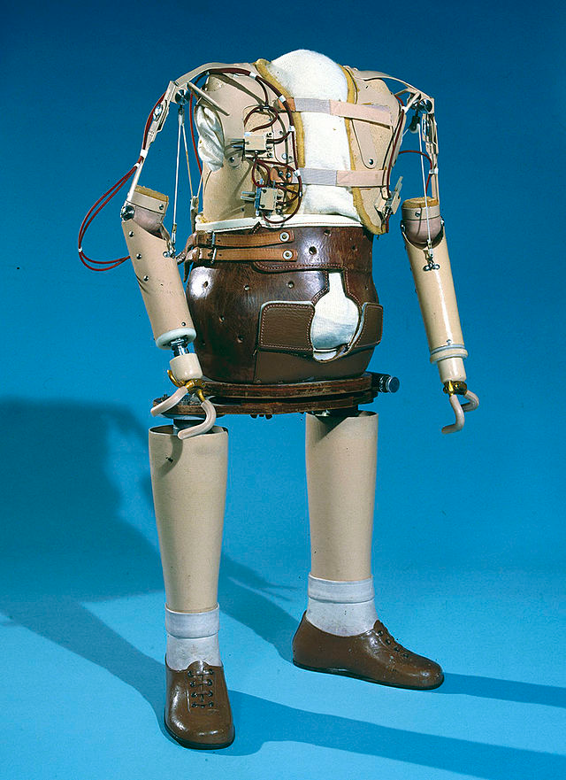
Thalidomide Disaster
First marketed in 1957 in West Germany
Primarily prescribed as a sedative or hypnotic
Claimed to cure “anxiety, insomnia, gastritis, and tension
Later, used against nausea and to alleviate morning sickness in pregnant women
Maker’s safety claims:
“completely safe” for everyone, including mother and child, “even during pregnancy”
By 1960, thalidomide was marketed in 46 countries
Australian obstetrician Dr. William McBride discovered that the drug also alleviated morning sickness. He started recommending this off-label use
Image: https://helix.northwestern.edu/article/thalidomide-tragedy-lessons-drug-safety-and-regulation

Slide 13
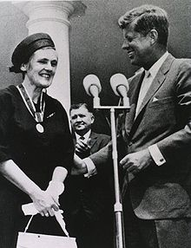
Thalidomide Disaster: Aftermath of scandal
In 1961, Dr. McBride began to associate this so-called harmless compound with severe birth defects in the babies he delivered
In Germany, between 5,000 and 7,000 infants were born with phocomelia (malformation of the limbs)
Only 40% of these children survived
In US, Frances Kathleen Oldham Kelsey, physician of US FDA, withheld approval of thalidomide and requested further studies despite pressure from thalidomide's manufacturer
Received the President's Award for Distinguished Federal Civilian Service from President John F. Kennedy for blocking sale of thalidomide in the United States in 1962
2010: FDA established the Dr. Frances O. Kelsey Drug Safety excellence Award.
Dr. Kelsey received the first Kelsey Award

Slide 14
History of Clinical Trials – Part 2
TCS Internal
14

Slide 15
Outline
History and timeline of FDA and other regulatory agencies
Modern day drug approval
Drug safety in recent times
Vioxx
Avandia
Some interesting approvals

Slide 16
History US FDA: Key Milestones (1/3)
1820: Eleven physicians meet in Washington, D.C.
Establish the U.S. Pharmacopeia, the first compendium of standard drugs for the United States.
1848: Drug Importation Act
Passed by Congress
Requires U.S. Customs Service inspection to stop entry of adulterated drugs from overseas.
1862: President Lincoln appoints a chemist, Charles M. Wetherill
To serve in the new Department of Agriculture.
Beginning of the Bureau of Chemistry, the predecessor of the Food and Drug Administration.
1902: The Biologics Control Act
To ensure purity and safety of serums, vaccines, and similar products
1906: The Meat Inspection Act
Insanitary conditions in meat-packing plants
Use of poisonous preservatives and dyes in foods
Cure-all claims for worthless and dangerous patent medicines
1927: Reorganization:
Regulatory functions are located in the Food, Drug, and Insecticide Administration
Ref: http://www.fda.gov/AboutFDA/WhatWeDo/History/Milestones/ucm128305.htm

Slide 17
History US FDA: Key Milestones (2/3)
1930: The name Food and Drug Administration (FDA) under an agricultural appropriations act
1937: Elixir of Sulfanilamide containing a poisonous solvent, kills 107 persons, many of whom are children
The public outcry caused by this Sulfanilamide tragedy led to the passing of
The Federal Food, Drug, and Cosmetic (FDC) Act of 1938
Requiring new drugs to be shown safe before marketing
Safe tolerances be set for unavoidable poisonous substances
Authorizing factory inspections
….
1949: FDA publishes guidance to industry for the first time.
Procedures for the Appraisal of the Toxicity of Chemicals in Food
1962: Post Thalidomide tragedy
Kefauver-Harris Drug Amendments passed
To ensure drug efficacy and greater drug safety.
For the first time, drug manufacturers are required to prove to FDA the effectiveness of their products before marketing them
Ref: http://www.fda.gov/AboutFDA/WhatWeDo/History/Milestones/ucm128305.htm

Slide 18
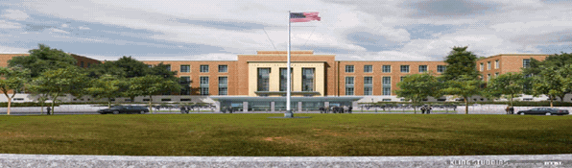
History US FDA: Key Milestones (3/3)
1970: FDA requires first patient package insert
1983: Orphan Drug Act passed
1985: AIDS test for blood approved by FDA
1991: Regulations published to Accelerate the Review of Drugs for life-threatening diseases
1995: FDA declares cigarettes to be "drug delivery devices." Restrictions are proposed
1998: Pediatric Rule: conduct studies to assess safety and efficacy in children
1999: www.ClinicalTrials.gov is founded
Ref: http://www.fda.gov/AboutFDA/WhatWeDo/History/Milestones/ucm128305.htm

Slide 19
EMA and Some Other Regulatory Agencies
EU: 1965:Need for Evidence based authorization of medicinal products
1995: European Medicines Agency (EMA) starts business
Japan: Began in 1979
2004: Pharmaceutical and Medical Devices Agency (PMDA) established
China: China Food and Drug Administration (CFDA)

Slide 20
Modern Day Drug Approval
Pre-Clinical
Clinical
Pre-Clinical
Target Selection
In Vitro
Ph 1
Safety
Healthy Volunteer
Ph 2
Safety
Dose Selection
Ph 3
Efficacy
Confirmatory
Ph 4
Long term safety
Lead Discovery
Chemistry
In vivo (Animal)
PK
PD
Patients
Some efficacy
In Patients
Moderate Sample Size
Safety
Large Sample Size
Compare
Post marketing Commitment
In patients
Small sample size

Slide 21
Requirements Outlined in FDA Guidance
Independent CV endpoints committee to prospectively adjudicate, in a blinded fashion – All Phase 2 and 3 trials
Trials are appropriately designed and conducted so that a meta-analysis can be performed
Obtain sufficient endpoints to allow a meaningful estimate of risk, the phase 2 and phase 3 programs
Include patients at higher risk of cardiovascular events
Sponsors should perform a meta-analysis of the important cardiovascular events across phase 2 and phase 3 controlled clinical trials and explore similarities and/or differences in subgroups (e.g., age, sex, race), if possible
The report of this meta-analysis should contain sufficient detail for all the analyses; conventional graphical plots for meta-analysis finding by study, subgroup, and overall risk ratio

Slide 22
FDA Avandia AdCom 2010
Ref: FDA Webpage

Slide 23
Avandia and Actos: A comparison
Ref: FDA Webpage

Slide 24
Introduction to Clinical Trials
TCS Internal
24

Slide 25
What are Clinical Trials?
Clinical trials are research studies that explore whether a medical strategy, treatment, or device is safe and effective for humans.
Clinical trials are one of the final stages of a long and careful research process. The process often begins in a laboratory, where scientists first develop and test new ideas.
If an approach seems promising, the next step may involve animal testing. This shows how the approach affects a living body and whether it's harmful.
But, an approach that works well in the lab or animals doesn't always work well in people. Thus, research in humans is needed.

Slide 26
What are clinical trials?
For safety purposes, clinical trials start with small groups of patients to find out whether a new approach causes any harm.
In later phases of clinical trials, researchers learn more about the new approach's risks and benefits.
Clinical research is done only if doctors don't know:
Whether a new approach works well in people and is safe
Which treatments or strategies work best for certain illnesses or groups of people

Slide 27
Clinical Trials – Guiding Principles
Ethics
Scientific validity and integrity
Medical relevance
Regulatory and medicolegal issues
Costs

Slide 28
Modern Day Drug Approval
Pre-Clinical
Clinical
Pre-Clinical
Target Selection
In Vitro
Ph 1
Safety
Healthy Volunteer
Ph 2
Safety
Dose Selection
Ph 3
Efficacy
Confirmatory
Ph 4
Long term safety
Lead Discovery
Chemistry
In vivo (Animal)
PK
PD
Patients
Some efficacy
In Patients
Moderate Sample Size
Safety
Large Sample Size
Compare
Post marketing Commitment
In patients
Small sample size

Slide 29
Clinical Trial Phases: Phase I
Phase I [small number of healthy volunteers; in certain cases, i.e., virology/oncology, also patients]
Goal: to understand what happens to the investigational compound in the body from the time it is swallowed or injected until it is excreted, when it is excreted and how the human body reacts to the new compound from a safety and tolerability point of view.
Study participants are monitored for the occurrence and severity of any side effects that they may experience.

Slide 30
Clinical Trial Phases: Phase II
Phase II
Goal: to evaluate the safety and efficacy of an investigational compound in patients with a specific disease or condition.
Typically conducted in a group of patients who are at the same stage of a disease.
Patients are given various doses of the compound and closely monitored to compare the effects and to determine the safest dosing regimen.
In many instances, multiple Phase II studies are conducted to test the compound in a variety of patient populations or indications.

Slide 31
Clinical trial phases: Phase III
Phase III
Goal: To confirm the safety and efficacy of an investigational compound, and the dosage regimen chosen, in large numbers of patients with a specific disease or condition.
The safety and efficacy of the investigational compound is compared to that of the currently accepted standard treatment or Placebo.
Information obtained from Phase III studies is used to determine how the compound is best prescribed to patients in the future.
The complete information available on the new compound is submitted to Health Authorities.

Slide 32
Clinical Trial Phases: Phase IV
Phase IV
Phase IV studies take place after the drug has been approved for marketing
These studies are designed:
to provide broader experience in evaluating the safety and effectiveness of the new drug in larger numbers of patients, subpopulations of patients, and to compare and/or combine it with other available treatments.
to evaluate the long-term effects of the drug. Under these circumstances, less common adverse events may be detected.

Slide 33
Clinical Trial Phases: Summary
Phase | Objective | Efficacy/Endpoint
Phase I | Safety evaluation Patient tolerance | None
Phase II | Identify efficacy endpoints and doses for Phase III | “Exploratory” Primary Secondary
Phase III | Efficacy & Safety Evaluate for general use | Primary- Indication Secondary- may be described in label
Phase IV | Expand efficacy & safety | Expand patient reported outcomes

Slide 34
Back up slides

Slide 35
Phase I Clinical Trial: Investigational New Drug Application (IND)
Pre-clinical testing on Animals
No safety signals
Some therapeutic areas / indications identified
May seek advise from FDA even before filing IND
Early communications between sponsors and new drug review divisions
Provide guidance on the data necessary to warrant IND submission
Issues related to data needed to support the rationale for testing a drug in humans;
Design of nonclinical pharmacology, toxicology, and drug activity studies
PK issues, known / unknown metabolites
FDA IND Regulations: 21 Code of Federal Regulations (CFR) 312 (Drugs and Biologics)

Slide 36
IND Requirements (Not all are listed here)
Chemistry
Strength of drug, impurities, stability, product consistency
Pharmacology an Toxicology data
Life threatening toxicity in rodents
Non-rodent (may be in dogs) to confirm tolerability
Proposed clinical trial with same schedule, duration, formulation and route as in PK and TOX studies
Choice of starting dose for first-in-human trial
Non-Onco
Healthy volunteers
Doses: for further studies; not Maximum Tolerated Dose (MTD)
Oncology
Usually cancer patients
Doses: for further studies; Maximum Tolerated Dose (MTD)

Slide 37
Beginning Studies in Human
FDA’s review of IND is complete
Also reviewed by a local Institutional Review Board (IRB)
What is an IRB?
IND Submission
IND Review
By FDA, IRB
30 Day Clinical Hold
Phase 1 Trial
Annual Reports
End of Phase 1 Meeting

Slide 38
Activities to be performed by Programmers
Read and Understand study Protocol
Read and understand CRF, CRF completion guidelines
Annotate CRFs(if required) or review Annotated CRFs
Read SAP
Database set up
Database UAT
Write Define files for SDTM/ADaMs
Create SDTM/ADaMs
Validate SDTM/ADaMs
Create TLFs
Validate TLFs

